Slide 1
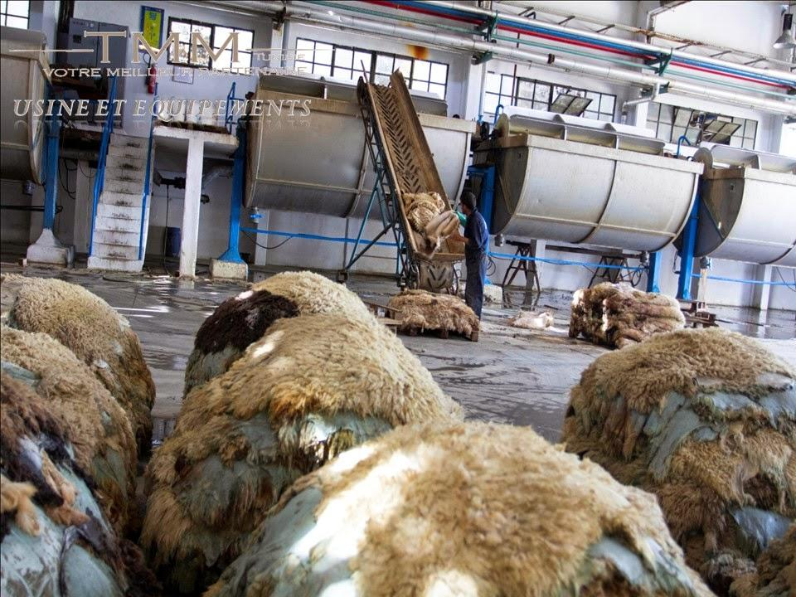
Chapter-12
Introduction to manufacture of leather

Slide 2
Cont’d
The hides and skins of animals are the source of leather.
The skins of large animals such as cattle and horses are referred to as hides.
Those of smaller animals such as sheep, goats and calves are called skins.
Leather making is a fairly complicated process:- even the same kinds of leather are not always prepared in the same way
Various leathers are manufactured depending on the interest of customers.

Slide 3
Process of leather making
Curing :- hides are first cured with salts.
This is done for preventing or slow down the decomposition of the skin.
All the hides must be preserved first before leather processing.

Slide 4
Soaking
In order to restore their original water content (loosing during preservation) skins are soaked in clean water.
This is also done for removing salts added during preservation and to remove dirt's and gives moisture to hides.
Liming
It is the process where leather is soften by alkaline solution in a drum. In this process hairs,protiens,fats and greases are removed from hides.
Liming takes 12 - 14 hours, which makes the skin very alkaline.
Fleshing
In this case the pelt is passed through a machine to remove flushing tissue from the flesh side.

Slide 5
Deliming
Flesh side deliming is the step in which weak acids like boric acid ,formic acid, lactic acid are used to neutralize the alkalis of the hides.
Ammonium sulphate is used during the deliming process and helps remove lime from the hides or skins
Otherwise, insoluble calcium tannates due to hardening of skin fibers, which can cause lime spots will occur.

Slide 6
Bating
Further measure of deliming.
Breakdown of the lime-soap generated during liming.
Further action on the protein fibres with a view to increasing the elasticity of the leather.
To obtain a fine silky grain
Bating, an enzymatic action for the removal of unwanted hide components after liming is performed to impart softness, stretch, and flexibility to the leather.

Slide 7
Pickling
Once bating is complete, the hides and skins are treated first with common salt (sodium chloride) and then with sulfuric acid, in case a mineral tanning is to be done.
This is done to bring down the pH of collagen to a very low level of 2.8-3.0 so as to facilitate the penetration of mineral tanning agent into the skin substrate. This process is known as pickling.

Slide 8
Tanning
Leather tanning is the process to prepare skins and hides for leather production. Leather tanning is done in a tannery.
Tanning hide into leather involves a process which permanently alters the protein structure of skin, making it more durable and less susceptible to decomposition, and coloring.
Hides and skins have the ability to absorb tannic acid and other chemical substances
This prevent them from decaying, make them resistant to wetting, and keep them supple and durable.
.

Slide 9
Cont’d
The most common tanning agents used is trivalent chromium and vegetable tannins extracted from specific tree barks.
Alum, syntans (man-made chemicals), formaldehyde, glutaraldehyde, and heavy oils are other tanning agents.
So there are two main types of tanning: Vegetable Tanning
& Chrome tanning.

Slide 10
Vegetable Tanning
Heavy leathers and sole leathers are produced by the vegetable tanning process.
In the vegetable tanning process, the concentration of the tanning materials starts out low and is gradually increased as the tannage proceeds.
It usually takes 3 weeks for the tanning material to penetrate to the center of the hide.
The skins or hides are then wring and may be cropped or split; heavy hides may be retanned and scrubbed.

Slide 11
Chrome Tanning
Chrome-tanned leather has:- higher thermal stability, is very stable in water, and takes less time to produce than vegetable-tanned leather.
In chrome tanning, the additional processes of retanning, dyeing, and fatliquoring are usually performed and a preliminary degreasing step may be necessary when using animal skins, such as sheep skin.

Slide 12
Crusting
Following tanning, shaving is done on a known greensides using a machine with helical blades for desired thickness.
Dyeing: is carried out to give variety of colors to leather, meeting the fashion requirement.
Lubrication(Fat liquoring) : is done with the addition of oil. It keeps the leather flexible and soft otherwise it will dry out.
Samming: is carried out to remove water.
Druming: separating fibers and makes more soft which is carried out in rotating drums.
Brushing :to remove extra dust.

Slide 13
Leather Finishing
Finishing process refers to all the steps that are carried out after drying.
During this Leather is treated with pigments, dyes, and resins to achieve a smooth, polished surface and the desired color.
Urethane is added for a glossy patent leather.

Slide 14
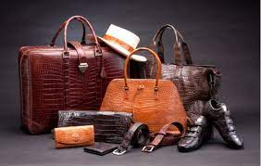
Finally with a lots of efforts leather is ready to make different items like bags, shoes, jackets, belts and many others

Slide 15
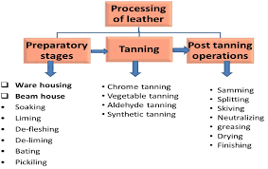
General flow diagram for leather tanning and finishing process

Slide 16
Health and environmental impact
The tanning process involves chemical and organic compounds that can have a detrimental effect on the environment.
Agents such as chromium, vegetable tannins, and aldehydes are used in the tanning step of the process.
Chemicals used in tanned leather production increase the levels of chemical oxygen demand and total dissolved solids in water when not disposed of responsibly.
These processes also use large quantities of water and produce large amounts of pollutants.

Slide 17
Cont’d
Boiling and sun drying can oxidize and convert the various chromium(III) compounds used in tanning intocarcinogenic hexavalent chromium, or chromium(VI).
This hexavalent chromium runoff and scraps arethen consumed by animals,, chickens (the most common source of protein).
Chromium is not solely responsible for these diseases.
Methylisothiazolinone, which is used for microbiological protection (fungal or bacterial growth), causes problems with the eyes and skin.

Slide 18
Cont’d
Anthracene, which is used as a leather tanning agent, can cause problems in the kidneys and liver and is also considered a carcinogen.
Formaldehyde and arsenic, which are used for leather finishing, cause health problems in the eyes, lungs, liver, kidneys, skin, and lymphatic system and are also considered carcinogens.
Generally, the waste from leather tanneries is detrimental to the environment and the people who live in it.

Slide 19
What should be done?
The most important approach for prevention of environmental pollution is getting an idea prevention is better than reuse which is better than disposal of wastes.
There are various recycling methods to make generated leather wastes into eco-friendly useful bi-products such as production of fatliquoring oils and bio-diesel from pre-fleshing wastes, production of activated carbon,gelatin, retanning agents etc., from shavings and trimmings, production of grease, methane gas, fertilizers, etc., from fleshing waste.
Hence cleaner production and recycling are the best options in order to control environmental pollution.

Slide 20
End of chapter-12

